Slide 1
Prototyping and Spikes
2017

Slide 2
Today’s Topics
Spikes
Prototyping Typology
The classic of all classics:
C. Floyd (1983)
The prototyping concept:
Be able to
Characterize the prototyping concept
Explain 3 classes of prototyping:
Exploratory
Experimental
Evolutionary
Explain how spikes can be used - suggest relevant usage of prototypes in XP (which class and when)
Relate the concepts protyping and spikes

Slide 3
Resources
C. Floyd - A systematic look on prototyping
Leffingwell- chap. 6: USER STORIES (spikes)

Slide 4
Spikes
Invention of XP, are a special type of story used to drive out risk and uncertainty in a user story or other project facet.

Slide 5
Spikes
Spikes may be used for a number of reasons.
Spikes may be used for basic research to familiarize the team with a new technology or domain.
The story may be too big to be estimated appropriately, and the team may use a spike to analyze the implied behavior so they can split the story into estimable pieces.
The story may contain significant technical risk, and the team may have to do some research or prototyping to gain confidence in a technological approach that will allow them to commit the user story to some future timebox.
The story may contain significant functional risk, in that although the intent of the story may be understood, it’s not clear how the system needs to interact with the user to achieve the benefit implied.

Slide 6
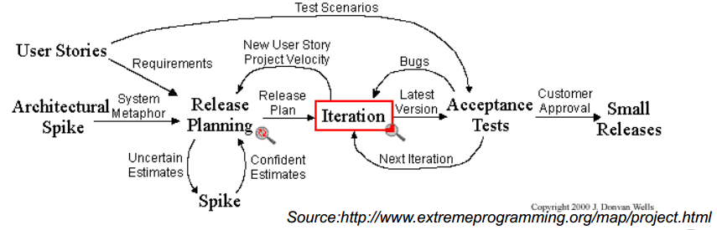
XP – Spikes
Spikes are used to
Reduce risk of technical problems
Enhance the reliability of user story estimation

Slide 7
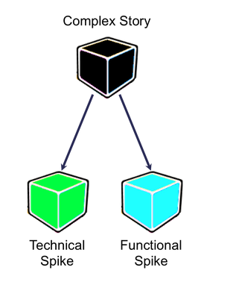
Technical and functional spikes
Special story to reduce risk and uncertainty
Technical risk – the team researches or prototype
Functional risk – the purpose of the story might be understood, but it is not clear to the team how the system shall interact with the users to achieve the expected outcome

Slide 8
Managing Spikes
Spikes are placed in the product backlog
Spikes are estimated as other user stories
The Exception, Not the Rule
Every user story has uncertainty and risk and can lead to spike activities i.e. experiments and discussions to reduce uncertainty
Spikes are reserved for critical and large unknowns
NB! Spikes are supposed to create knowledge/information – NOT production code
Decisions, prototypes mock-ups etc.

Slide 9
Technical and functional spikes - example
Some user stories might need both types of spikes
As a costumer, I want to see my daily energy use in a histogram so that I can quickly understand my past, current and projected energy consumption
Technical spike
Research how long it takes to update the customer display to current usage, determining communication requirements, bandwidth, and whether to push or pull data
Functional spike
Prototype a histogram and get user feedback in order to see if you have understood the requirements correct – handshake

Slide 10
Special spikes
User Experience Story Spikes
Create different user interfaces and try them out on the actual end users
Will probably not result in shippable software
Architecture spike
The idea of the architecture spike is setting the initial skeleton and creating a single vision of how it might structured
The goal of this architecture spike is to rough out subsystem boundaries, transition points between software layers, (physical) constraints, etc.

Slide 11
Prototyping

Slide 12
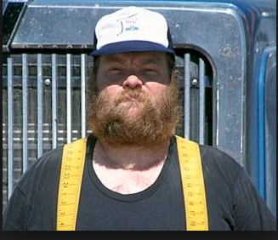
The Design Life Cycle
Why do we need to constantly try out, test, evaluate our ideas, concepts and prototype?
What “kind” of user do you see?

Slide 13
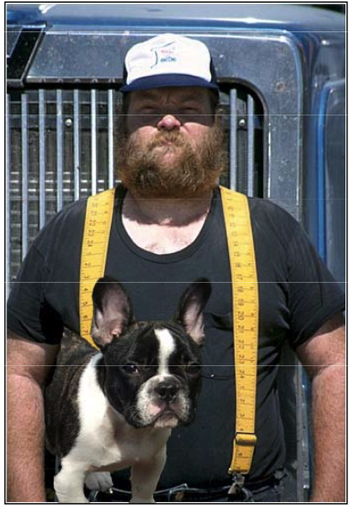
The Design Life Cycle
Why do we need to constantly try out, test, evaluate our ideas, concepts and prototype?
Designer´s perception

Slide 14
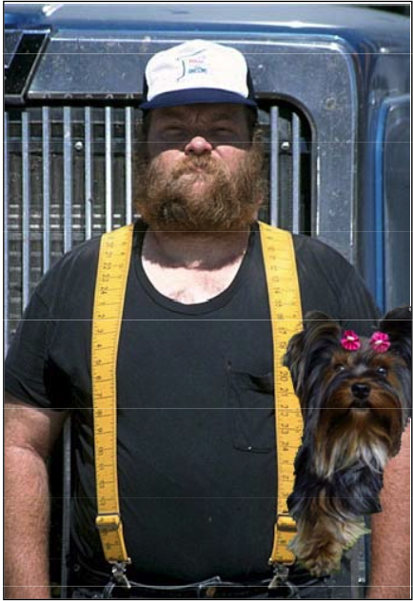
The Design Life Cycle
Why do we need to constantly try out, test, evaluate our ideas, concepts and prototype?
Designer´s perception
User self perception

Slide 15
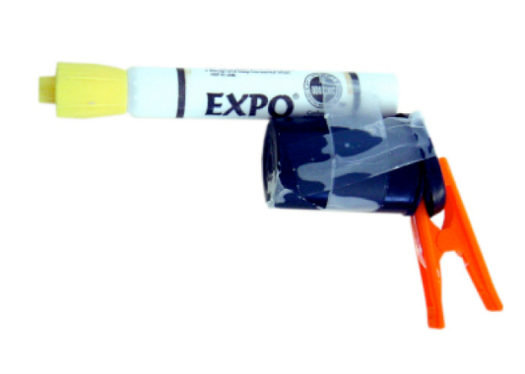
What is prototyping - Types
Source Rough prototype from Ideo
Industry
First of a kind for mass production,
I.e. prototype = copy of finished product
Architecture and city planning
Model in reduced scale, often for one piece production
Software Development
Often only one product
Often very vague product requirements
Prototyping (process) and not the prototype (product) is in focus
i.e. the production of the prototype

Slide 16
What is prototyping - Construction
Less work compared to building the real system
Functional selection
Extensive use of tools
Construct with focus on evaluating and not on use in real situations, i.e. not focus on:
Reliability
Security
Effectiveness

Slide 17
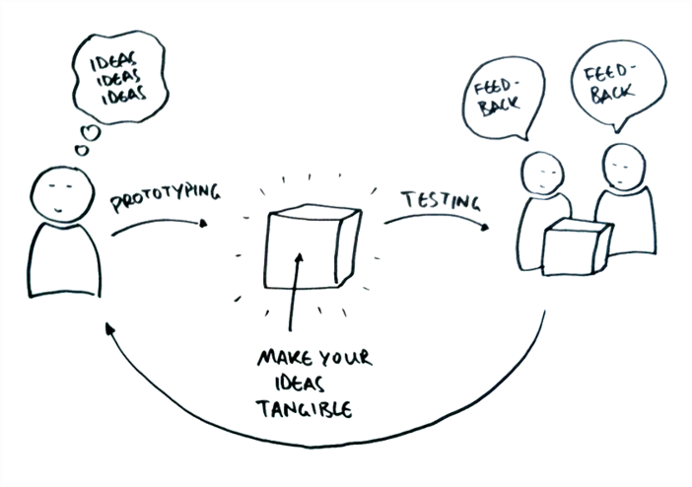
What is prototyping
Always part of the leaning process in system development
What shall we produce?
How shall we do it?
Can we do it?
Traditionally focused on interactive systems
Systems with intensive user interaction
Dialogue between end-user and developer
Also relevant in technical areas
Technical possibilities
Dialog/knowledge sharing between developers

Slide 18
What is prototyping
Evaluating
Important to allocate many resources to this activity
Test/Trying
Commenting, discussing
Future use
The basis for new prototypes – throw-away
Part of the system to be build

Slide 19
Prototyping steps
Functional selection
Construction
Evaluation
Further use
Functional selection
Construction
Evaluation
Further use?

Slide 20
Typology for prototypes
Explorative prototypes
What shall the system be able to do?
Requirement elicitation
Experimental prototypes
Is this how the system can handle the requirements?
Evaluate possible solutions
Evolutionary prototypes
Incremental adoption of the system to changing requirements

Slide 21
Explorative prototypes
Catalyst for communication between end-user and developers
Often the user are presented for alternatives
The prototype is normally thrown away
The prototype is build with intensive use of tools
NB!
It can be relevant to deliberately produces ‘bad’ prototypes

Slide 22
Experimental prototypes
Proposals are evaluated after experimental use
Full functional simulation
Can not be used as production system
Extensive use of tools
HCI simulations
Lower layers are simulated
No validation of input
Horizontal prototype
Skeleton programming
Typical parts are selected and constructed
Vertical prototyping

Slide 23
Evolutionary prototypes
Hardly a prototype
Development of versions
Relevant because
Use/work situations always change
Introduction of IT systems changes the organization and therefore the requirements also change
The system becomes a prototype when development of next version is started
The system was not build as a prototype – but as a system

Slide 24
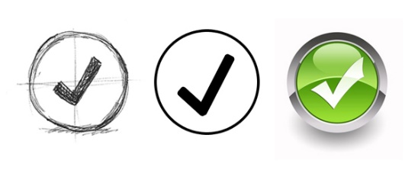
Low and High fidelity prototypes
Prototypes can be categorized as Low Fidelity prototypes (e.g. paper prototypes) and High Fidelity prototypes.
Low Fidelity prototypes do not look much like the final product. They are not made from the same materials as the final product and do not have all the functionality of the final product. Low fidelity prototype can simulate some of the interactions, but perhaps not all the subtleties of the interaction.
High Fidelity prototypes look more like the final product. Your final design is an example of a high fidelity prototype. They may have some of the functions of the final product. They can test more of the subtleties of the interactions. But they take more time to make.

Slide 25
Low and High fidelity prototypes
 | Advantages | Disadvantages
Low-Fidelity | Lower development cost Evaluate multiple designs Useful communication device Address screen layout issues Useful for identifying market requirements Proof-concepts | Limited error checking Poor detailed specifications for coding Facilitator-driven Limited utility after requirements established Limited usefulness for usability tests Navigation and flow limitations
High-Fidelity | Complete Functionality Fully interactive User-driven Clearly defines navigational scheme Use for exploration and test Look and feel of final product Serves as a living specification Marketing and sales tool | More expensive to develop Time consuming to create Inefficient for proof of concepts Not effective for requirements gathering
The point is that before proceeding to a high-fidelity prototype, be sure that your design is good by making lots of low-fidelity prototypes.

Slide 26
Different features
Horizontal and vertical prototyping
There are two dimensions along witch a prototype can vary
Horizontal
Board, but only presentation layer
Vertical
Deep, but narrow
Horizontal
Functionality
Vertical
Full System

Slide 27
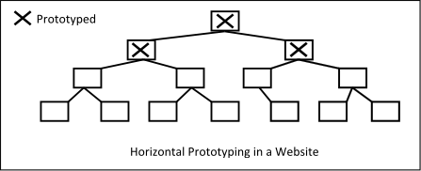
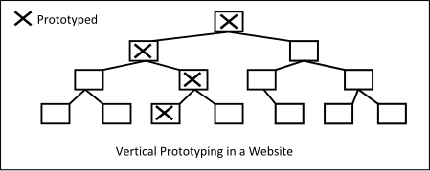
Prototyping in a website

Slide 28
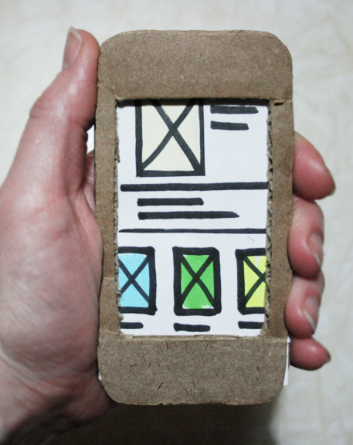
Paper prototyping
In human–computer interaction, paper prototyping is a widely used method in the user-centered design process, a process that helps developers to create software that meets the user's expectations and needs—in this case, especially for designing and testing user interfaces.
It is throwaway prototyping and involves creating rough, even hand-sketched, drawings of an interface to use as prototypes, or models, of a design.
While paper prototyping seems simple, this method of usability testing can provide a great deal of useful feedback which will result in the design of better products.
This is supported by many usability professionals.
https://en.wikipedia.org/wiki/Paper_prototyping

Slide 29
Paper prototyping
Pros
Cons
Allows you to incorporate feedback immediately
They’re quick to create
Cheap
Encourages collaboration
Can be applied to many different platforms
Smart phone
Tablet
Desktop
Smart watch
Some interactions are just difficult to replicate in an elegant fashion using paper prototypes
It is difficult to share with people that are not physically present

Slide 30
Main points
Prototyping is not a systems development method – it is a procedure in almost all system development methods
Use of prototyping in an overall process:
Requirement elicitation
Use of explorative prototyping / functional spikes
Go through a number of experiments until changes are small (stability in requirements)
Requirement are verified
Use of experimental prototyping / technical spikes
Develop the system with use of a incremental approach Requirements are realized
Use of experimental prototyping

Slide 31
Exercise 1.1 – Design face
Design an interface for a small screen, smart phone or tablet, that controls the climate in a house
Your job is to design the end-user interface to do things like:
Set the desired temperature and air flow for a room, or for the whole house
See what the temperature and setting is for a place in the house
Schedule temperature changes according to a fixed plan (day and night, weekends,…)
See energy use information in a way that helps determine the best settings
Your group have 45 - 60 minutes to this steps:
Sketch the different screens of your interface
Using cards, Post-it, tape, etc., design a “working” paper prototype
Test this prototype on a member of another group, making notes on the problems and potential design changes

Slide 32
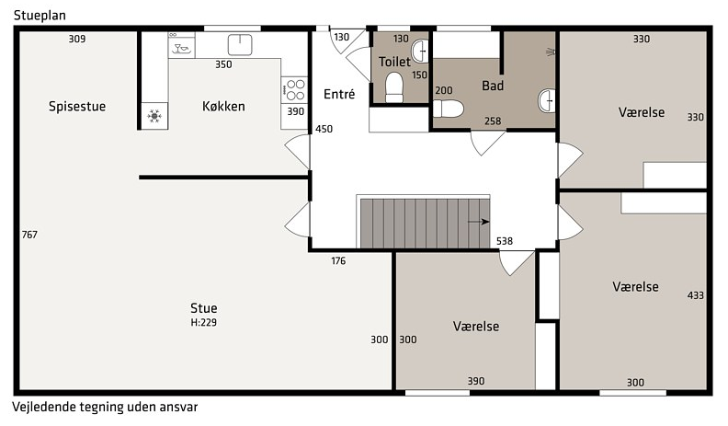
Exercise 1.2 – Test face
Design an interface for a small screen, smart phone or tablet, that controls the climate in a house
Roles:
Test-leader
Observer
Tester – for another group
Test the prototype on a member of another group.
Test-leader are responsible for the test and the instruction of the test person.
Observer has to make notes on the problems and potential design changes during the test.

Slide 33
Video
http://www.lynda.com/Web-Interaction-Design-tutorials/Foundations-UX-Prototyping/133349-2.html
http://www.lynda.com/Web-Prototyping-tutorials/What-paper-prototyping/161093/171561-4.html

